Slide 1
Chapter 15 – Multithreading
Outline
15.1 Introduction
15.2 Class Thread: An Overview of the Thread Methods
15.3 Thread States: Life Cycle of a Thread
15.4 Thread Priorities and Thread Scheduling
15.5 Thread Synchronization
15.6 Producer/Consumer Relationship without Thread Synchronization
15.7 Producer/Consumer Relationship with Thread Synchronization
15.8 Producer/Consumer Relationship: The Circular Buffer
15.9 Daemon Threads
15.10 Runnable Interface
15.11 Thread Groups
15.12 (Optional Case Study) Thinking About Objects: Multithreading
15.13 (Optional) Discovering Design Patterns: Concurrent Design Patterns

Slide 2
15.1 Introduction
Concurrency normally available in OS primitives
Java provides built-in multithreading
  Multithreading improves the performance of some programs

Slide 3
15.2 Class Thread: An Overview of the Thread Methods
Class Thread constructors
public Thread( String threadName )
public Thread()
Code for thread in thread’s run method
Method sleep makes thread inactive
Method interrupt interrupts a running thread
Method isAlive checks status of a thread
Method setName sets a thread’s name
Method join
  Waits for thread to finish and continues from current thread

Slide 4
15.3 Threaded States: Life Cycle of a Thread
Thread states
  Born state
    Thread was just created
  Ready state
    Thread’s start method invoked
    Thread can now execute
  Running state
    Thread is assigned a processor and running
  Dead state
    Thread has completed or exited
    Eventually disposed of by system

Slide 5
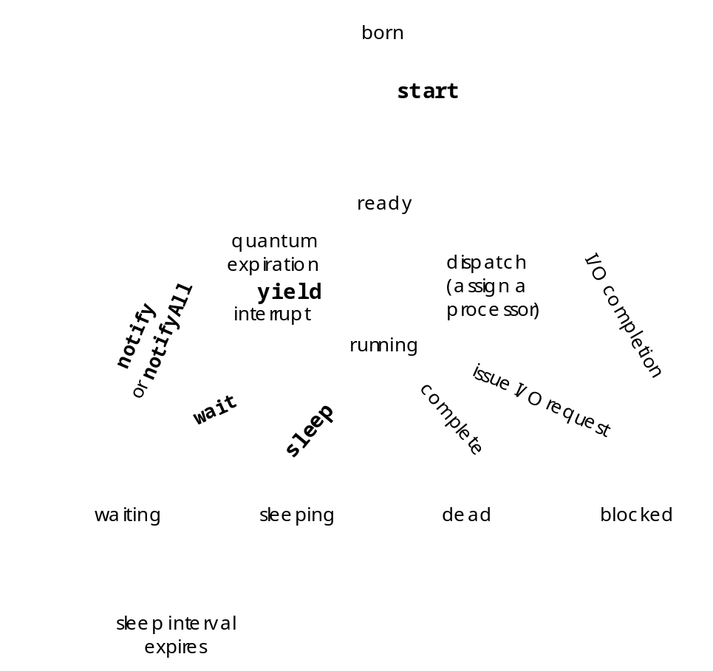
15.3 Thread States: Life Cycle of a Thread
Fig. 15.1 State diagram showing the Life cycle of a thread.

Slide 6
15.4 Thread Priorities and Thread Scheduling
Java thread priority
  Priority in range 1-10
Timeslicing
  Each thread assigned time on the processor by quantum
  Keeps highest priority threads running

Slide 7
ThreadTester.java
Lines 4-28
1 // Fig. 15.3: ThreadTester.java
2 // Show multiple threads printing at different intervals.
3
4 public class ThreadTester {
5
6 // create and start threads
7 public static void main( String args[] )
8 {
9 PrintThread thread1, thread2, thread3, thread4;
10
11 // create four PrintThread objects
12 thread1 = new PrintThread( "thread1" );
13 thread2 = new PrintThread( "thread2" );
14 thread3 = new PrintThread( "thread3" );
15 thread4 = new PrintThread( "thread4" );
16
17 System.err.println( "\nStarting threads" );
18
19 // start executing PrintThreads
20 thread1.start();
21 thread2.start();
22 thread3.start();
23 thread4.start();
24
25 System.err.println( "Threads started\n" );
26 }
27
28 } // end class ThreadTester
29
Class ThreadTester creates four PrintThreads and calls their start methods

Slide 8
ThreadTester.java
Lines 33-71
Lines 38-48
Lines 51-69
30 // Each object of this class picks a random sleep interval.
31 // When a PrintThread executes, it prints its name, sleeps,
32 // prints its name again and terminates.
33 class PrintThread extends Thread {
34 private int sleepTime;
35
36 // PrintThread constructor assigns name to thread
37 // by calling superclass Thread constructor
38 public PrintThread( String name )
39 {
40 super( name );
41
42 // sleep between 0 and 5 seconds
43 sleepTime = (int) ( Math.random() * 5000 );
44
45 // display name and sleepTime
46 System.err.println(
47 "Name: " + getName() + "; sleep: " + sleepTime );
48 }
49
50 // control thread's execution
51 public void run()
52 {
53 // put thread to sleep for a random interval
54 try {
55 System.err.println( getName() + " going to sleep" );
56
57 // put thread to sleep
58 Thread.sleep( sleepTime );
59 }
PrintThread inherits from Thread so each object of the class can execute in parallel
Constructor initializes sleepTime to be 0 to 4.999 seconds and outputs name and value of sleepTime
Thread run method prints a String saying the thread is going to sleep and thread sleeps

Slide 9
ThreadTester.java
Line 68
60
61 // if thread interrupted during sleep, catch exception
62 // and display error message
63 catch ( InterruptedException interruptedException ) {
64 System.err.println( interruptedException.toString() );
65 }
66
67 // print thread name
68 System.err.println( getName() + " done sleeping" );
69 }
70
71 } // end class PrintThread
Thread prints name when done sleeping

Slide 10
Program Output
Name: thread1; sleep: 3593
Name: thread2; sleep: 2653
Name: thread3; sleep: 4465
Name: thread4; sleep: 1318
Starting threads
Threads started
thread1 going to sleep
thread2 going to sleep
thread3 going to sleep
thread4 going to sleep
thread4 done sleeping
thread2 done sleeping
thread1 done sleeping
thread3 done sleeping
Name: thread1; sleep: 2753
Name: thread2; sleep: 3199
Name: thread3; sleep: 2797
Name: thread4; sleep: 4639
Starting threads
Threads started
thread1 going to sleep
thread2 going to sleep
thread3 going to sleep
thread4 going to sleep
thread1 done sleeping
thread3 done sleeping
thread2 done sleeping
thread4 done sleeping

Slide 11
15.5 Thread Synchronization
Java uses monitors for thread synchronization
The sychronized keyword
  Every synchronized method of an object has a monitor
  One thread inside a synchronized method at a time
  All other threads block until method finishes
  Next highest priority thread runs when method finishes

Slide 12
15.6 Producer/Consumer Relationship without Synchronization
Buffer
  Shared memory region
Producer thread
  Calls produce method to add item to buffer
  Calls wait if consumer has not read last message in buffer
  Writes to empty buffer and calls notify for consumer
Consumer thread
  Reads message from buffer
  Calls wait if buffer empty
Synchronize threads to avoid corrupted data

Slide 13
ProduceInteger.java
Line 10
Lines 15-37
1 // Fig. 15.4: ProduceInteger.java
2 // Definition of threaded class ProduceInteger
3 public class ProduceInteger extends Thread {
4 private HoldIntegerUnsynchronized sharedObject;
5
6 // initialize ProduceInteger thread object
7 public ProduceInteger( HoldIntegerUnsynchronized shared )
8 {
9 super( "ProduceInteger" );
10 sharedObject = shared;
11 }
12
13 // ProduceInteger thread loops 10 times and calls
14 // sharedObject's setSharedInt method each time
15 public void run()
16 {
17 for ( int count = 1; count <= 10; count++ ) {
18
19 // sleep for a random interval
20 try {
21 Thread.sleep( ( int ) ( Math.random() * 3000 ) );
22 }
23
24 // process InterruptedException during sleep
25 catch( InterruptedException exception ) {
26 System.err.println( exception.toString() );
27 }
28
29 // call sharedObject method from this
30 // thread of execution
31 sharedObject.setSharedInt( count );
32 }
Instance variable sharedObject refers to object shared
Method run loops 10 times, sleeping 0-3 seconds and calling setSharedInt

Slide 14
ProduceInteger.java
Lines 34-36
33
34 System.err.println(
35 getName() + " finished producing values" +
36 "\nTerminating " + getName() );
37 }
38
39 } // end class ProduceInteger
Thread prints that it finished

Slide 15
ConsumeInteger.java
Line 10
Lines 15-39
Line 23
Lines 31-32
1 // Fig. 15.5: ConsumeInteger.java
2 // Definition of threaded class ConsumeInteger
3 public class ConsumeInteger extends Thread {
4 private HoldIntegerUnsynchronized sharedObject;
5
6 // initialize ConsumerInteger thread object
7 public ConsumeInteger( HoldIntegerUnsynchronized shared )
8 {
9 super( "ConsumeInteger" );
10 sharedObject = shared;
11 }
12
13 // ConsumeInteger thread loops until it receives 10
14 // from sharedObject's getSharedInt method
15 public void run()
16 {
17 int value, sum = 0;
18
19 do {
20
21 // sleep for a random interval
22 try {
23 Thread.sleep( (int) ( Math.random() * 3000 ) );
24 }
25
26 // process InterruptedException during sleep
27 catch( InterruptedException exception ) {
28 System.err.println( exception.toString() );
29 }
30
31 value = sharedObject.getSharedInt();
32 sum += value;
33
34 } while ( value != 10 );
Initializes sharedObject to refer to object shared
Method run contains a do/while structure that loops 10 times
Each iteration causes the thread to sleep 0-3 seconds
Call method getSharedInt and assign to variable sum

Slide 16
ConsumeInteger.java
Lines 36-38
35
36 System.err.println(
37 getName() + " retrieved values totaling: " + sum +
38 "\nTerminating " + getName() );
39 }
40
41 } // end class ConsumeInteger
Thread prints that it is done consuming

Slide 17
HoldIntegerUnsynchronized.java
Line 4
Lines 7-13
Lines 16-22
1 // Fig. 15.6: HoldIntegerUnsynchronized.java
2 // Definition of class HoldIntegerUnsynchronized.
3 public class HoldIntegerUnsynchronized {
4 private int sharedInt = -1;
5
6 // unsynchronized method to place value in sharedInt
7 public void setSharedInt( int value )
8 {
9 System.err.println( Thread.currentThread().getName() +
10 " setting sharedInt to " + value );
11
12 sharedInt = value;
13 }
14
15 // unsynchronized method return sharedInt's value
16 public int getSharedInt()
17 {
18 System.err.println( Thread.currentThread().getName() +
19 " retrieving sharedInt value " + sharedInt );
20
21 return sharedInt;
22 }
23
24 } // end class HoldIntegerUnsynchronized
Instance variable sharedInt is the shared buffer
Method setSharedInt not synchronized
Method getSharedInt not synchronized

Slide 18
SharedCell.java
Lines 6-20
1 // Fig. 15.7: SharedCell.java
2 // Show multiple threads modifying shared object.
3 public class SharedCell {
4
5 // execute application
6 public static void main( String args[] )
7 {
8 HoldIntegerUnsynchronized sharedObject =
9 new HoldIntegerUnsynchronized();
10
11 // create threads
12 ProduceInteger producer =
13 new ProduceInteger( sharedObject );
14 ConsumeInteger consumer =
15 new ConsumeInteger( sharedObject );
16
17 // start threads
18 producer.start();
19 consumer.start();
20 }
21
22 } // end class SharedCell
Method main creates a ProduceInteger thread and a ConsumeInteger thread and starts them

Slide 19
Program Output
ConsumeInteger retrieving sharedInt value -1
ConsumeInteger retrieving sharedInt value -1
ProduceInteger setting sharedInt to 1
ProduceInteger setting sharedInt to 2
ConsumeInteger retrieving sharedInt value 2
ProduceInteger setting sharedInt to 3
ProduceInteger setting sharedInt to 4
ProduceInteger setting sharedInt to 5
ConsumeInteger retrieving sharedInt value 5
ProduceInteger setting sharedInt to 6
ProduceInteger setting sharedInt to 7
ProduceInteger setting sharedInt to 8
ConsumeInteger retrieving sharedInt value 8
ConsumeInteger retrieving sharedInt value 8
ProduceInteger setting sharedInt to 9
ConsumeInteger retrieving sharedInt value 9
ConsumeInteger retrieving sharedInt value 9
ProduceInteger setting sharedInt to 10
ProduceInteger finished producing values
Terminating ProduceInteger
ConsumeInteger retrieving sharedInt value 10
ConsumeInteger retrieved values totaling: 49
Terminating ConsumeInteger
Output of numbers is not properly synchronized

Slide 20
15.7 Producer/Consumer Relationship with Thread Synchronization
Synchronize threads to ensure correct data

Slide 21
ProduceInteger.java
Line 10
Lines 15-37
1 // Fig. 15.8: ProduceInteger.java
2 // Definition of threaded class ProduceInteger
3 public class ProduceInteger extends Thread {
4 private HoldIntegerSynchronized sharedObject;
5
6 // initialize ProduceInteger thread object
7 public ProduceInteger( HoldIntegerSynchronized shared )
8 {
9 super( "ProduceInteger" );
10 sharedObject = shared;
11 }
12
13 // ProduceInteger thread loops 10 times and calls
14 // sharedObject's setSharedInt method each time
15 public void run()
16 {
17 for ( int count = 1; count <= 10; count++ ) {
18
19 // sleep for a random interval
20 try {
21 Thread.sleep( ( int ) ( Math.random() * 3000 ) );
22 }
23
24 // process InterruptedException during sleep
25 catch( InterruptedException exception ) {
26 System.err.println( exception.toString() );
27 }
28
29 // call sharedObject method from this
30 // thread of execution
31 sharedObject.setSharedInt( count );
32 }
33
Instance variable sharedObject refers to object shared
Method run loops 10 times, sleeping 0-3 seconds and calling setSharedInt

Slide 22
ProduceInteger.java
Lines 34-36
34 System.err.println(
35 getName() + " finished producing values" +
36 "\nTerminating " + getName() );
37 }
38
39 } // end class ProduceInteger
Thread prints that it finished

Slide 23
ConsumeInteger.java
Line 10
Lines 15-39
Line 23
Lines 31-32
1 // Fig. 15.9: ConsumeInteger.java
2 // Definition of threaded class ConsumeInteger
3 public class ConsumeInteger extends Thread {
4 private HoldIntegerSynchronized sharedObject;
5
6 // initialize ConsumerInteger thread object
7 public ConsumeInteger( HoldIntegerSynchronized shared )
8 {
9 super( "ConsumeInteger" );
10 sharedObject = shared;
11 }
12
13 // ConsumeInteger thread loops until it receives 10
14 // from sharedObject's getSharedInt method
15 public void run()
16 {
17 int value, sum = 0;
18
19 do {
20
21 // sleep for a random interval
22 try {
23 Thread.sleep( (int) ( Math.random() * 3000 ) );
24 }
25
26 // process InterruptedException during sleep
27 catch( InterruptedException exception ) {
28 System.err.println( exception.toString() );
29 }
30
31 value = sharedObject.getSharedInt();
32 sum += value;
33
34 } while ( value != 10 );
Initializes sharedObject to refer to object shared
Method run contains a do/while structure that loops 10 times
Each iteration causes the thread to sleep 0-3 seconds
Call method getSharedInt and assign to variable sum

Slide 24
ConsumeInteger.java
Lines 36-38
35
36 System.err.println(
37 getName() + " retrieved values totaling: " + sum +
38 "\nTerminating " + getName() );
39 }
40
41 } // end class ConsumeInteger
Thread prints that it is done consuming

Slide 25
HoldIntegerSynchronized.java
Line 6
Line 7
Lines 12-39
Line 14
1 // Fig. 15.10: HoldIntegerSynchronized.java
2 // Definition of class HoldIntegerSynchronized that
3 // uses thread synchronization to ensure that both
4 // threads access sharedInt at the proper times.
5 public class HoldIntegerSynchronized {
6 private int sharedInt = -1;
7 private boolean writeable = true; // condition variable
8
9 // synchronized method allows only one thread at a time to
10 // invoke this method to set the value for a particular
11 // HoldIntegerSynchronized object
12 public synchronized void setSharedInt( int value )
13 {
14 while ( !writeable ) { // not the producer's turn
15
16 // thread that called this method must wait
17 try {
18 wait();
19 }
20
21 // process Interrupted exception while thread waiting
22 catch ( InterruptedException exception ) {
23 exception.printStackTrace();
24 }
25 }
26
27 System.err.println( Thread.currentThread().getName() +
28 " setting sharedInt to " + value );
29
30 // set new sharedInt value
31 sharedInt = value;
32
Variable sharedInt represents the shared buffer
Variable writeable is the monitor condition variable
Method setSharedInt now synchronized
Check if sharedInt can be written

Slide 26
HoldIntegerSynchronized.java
Lines 44-70
Line 46
33 // indicate that producer cannot store another value until
34 // a consumer retrieve current sharedInt value
35 writeable = false;
36
37 // tell a waiting thread to become ready
38 notify();
39 }
40
41 // synchronized method allows only one thread at a time to
42 // invoke this method to get the value for a particular
43 // HoldIntegerSynchronized object
44 public synchronized int getSharedInt()
45 {
46 while ( writeable ) { // not the consumer's turn
47
48 // thread that called this method must wait
49 try {
50 wait();
51 }
52
53 // process Interrupted exception while thread waiting
54 catch ( InterruptedException exception ) {
55 exception.printStackTrace();
56 }
57 }
58
59 // indicate that producer cant store another value
60 // because a consumer just retrieved sharedInt value
61 writeable = true;
62
63 // tell a waiting thread to become ready
64 notify();
65
66 System.err.println( Thread.currentThread().getName() +
67 " retrieving sharedInt value " + sharedInt );
Method getSharedInt now synchronized
Check if sharedInt can be read

Slide 27
HoldIntegerSynchronized.java
68
69 return sharedInt;
70 }
71
72 } // end class HoldIntegerSynchronized

Slide 28
SharedCell.java
Lines 6-20
1 // Fig. 15.11: SharedCell.java
2 // Show multiple threads modifying shared object.
3 public class SharedCell {
4
5 // execute application
6 public static void main( String args[] )
7 {
8 HoldIntegerSynchronized sharedObject =
9 new HoldIntegerSynchronized();
10
11 // create threads
12 ProduceInteger producer =
13 new ProduceInteger( sharedObject );
14 ConsumeInteger consumer =
15 new ConsumeInteger( sharedObject );
16
17 // start threads
18 producer.start();
19 consumer.start();
20 }
21
22 } // end class SharedCell
Method main creates a ProduceInteger thread and a ConsumeInteger thread and starts them

Slide 29
Program Output
ProduceInteger setting sharedInt to 1
ConsumeInteger retrieving sharedInt value 1
ProduceInteger setting sharedInt to 2
ConsumeInteger retrieving sharedInt value 2
ProduceInteger setting sharedInt to 3
ConsumeInteger retrieving sharedInt value 3
ProduceInteger setting sharedInt to 4
ConsumeInteger retrieving sharedInt value 4
ProduceInteger setting sharedInt to 5
ConsumeInteger retrieving sharedInt value 5
ProduceInteger setting sharedInt to 6
ConsumeInteger retrieving sharedInt value 6
ProduceInteger setting sharedInt to 7
ConsumeInteger retrieving sharedInt value 7
ProduceInteger setting sharedInt to 8
ConsumeInteger retrieving sharedInt value 8
ProduceInteger setting sharedInt to 9
ConsumeInteger retrieving sharedInt value 9
ProduceInteger setting sharedInt to 10
ProduceInteger finished producing values
Terminating ProduceInteger
ConsumeInteger retrieving sharedInt value 10
ConsumeInteger retrieved values totaling: 55
Terminating ConsumeInteger
Output of numbers is properly synchronized

Slide 30
15.8 Producer/Consumer Relationship: The Circular Buffer
Circular buffer
  Multiple memory cells
  Produce item if one or more empty cells
  Consume item if one or more filled cells

Slide 31
UpdateThread.java
Lines 7-24
Lines 19-22
1 // Fig. 15.12: UpdateThread.java
2 // Class for updating JTextArea with output.
3
4 // Java extension packages
5 import javax.swing.*;
6
7 public class UpdateThread extends Thread {
8 private JTextArea outputArea;
9 private String messageToOutput;
10
11 // initialize outputArea and message
12 public UpdateThread( JTextArea output, String message )
13 {
14 outputArea = output;
15 messageToOutput = message;
16 }
17
18 // method called to update outputArea
19 public void run()
20 {
21 outputArea.append( messageToOutput );
22 }
23
24 } // end class UpdateThread
Class UpdateThread passed as a parameter to SwingUtilities method invokeLater to ensure GUI updates properly
Method run appends text to outputArea

Slide 32
ProduceInteger.java
Line 9
1 // Fig. 15.13: ProduceInteger.java
2 // Definition of threaded class ProduceInteger
3
4 // Java extension packages
5 import javax.swing.*;
6
7 public class ProduceInteger extends Thread {
8 private HoldIntegerSynchronized sharedObject;
9 private JTextArea outputArea;
10
11 // initialize ProduceInteger
12 public ProduceInteger( HoldIntegerSynchronized shared,
13 JTextArea output )
14 {
15 super( "ProduceInteger" );
16
17 sharedObject = shared;
18 outputArea = output;
19 }
20
21 // ProduceInteger thread loops 10 times and calls
22 // sharedObject's setSharedInt method each time
23 public void run()
24 {
25 for ( int count = 1; count <= 10; count++ ) {
26
27 // sleep for a random interval
28 // Note: Interval shortened purposely to fill buffer
29 try {
30 Thread.sleep( (int) ( Math.random() * 500 ) );
31 }
32
Places output in JTextArea outputArea

Slide 33
ProduceInteger.java
Lines 42-44
33 // process InterruptedException during sleep
34 catch( InterruptedException exception ) {
35 System.err.println( exception.toString() );
36 }
37
38 sharedObject.setSharedInt( count );
39 }
40
41 // update Swing GUI component
42 SwingUtilities.invokeLater( new UpdateThread( outputArea,
43 "\n" + getName() + " finished producing values" +
44 "\nTerminating " + getName() + "\n" ) );
45 }
46
47 } // end class ProduceInteger
SwingUtilities method invokeLater ensures GUI updates properly

Slide 34
ConsumerInteger.java
Line 9
1 // Fig. 15.14: ConsumeInteger.java
2 // Definition of threaded class ConsumeInteger
3
4 // Java extension packages
5 import javax.swing.*;
6
7 public class ConsumeInteger extends Thread {
8 private HoldIntegerSynchronized sharedObject;
9 private JTextArea outputArea;
10
11 // initialize ConsumeInteger
12 public ConsumeInteger( HoldIntegerSynchronized shared,
13 JTextArea output )
14 {
15 super( "ConsumeInteger" );
16
17 sharedObject = shared;
18 outputArea = output;
19 }
20
Places output in JTextArea outputArea

Slide 35
ConsumerInteger.java
Lines 45-47
21 // ConsumeInteger thread loops until it receives 10
22 // from sharedObject's getSharedInt method
23 public void run()
24 {
25 int value, sum = 0;
26
27 do {
28
29 // sleep for a random interval
30 try {
31 Thread.sleep( (int) ( Math.random() * 3000 ) );
32 }
33
34 // process InterruptedException during sleep
35 catch( InterruptedException exception ) {
36 System.err.println( exception.toString() );
37 }
38
39 value = sharedObject.getSharedInt();
40 sum += value;
41
42 } while ( value != 10 );
43
44 // update Swing GUI component
45 SwingUtilities.invokeLater( new UpdateThread( outputArea,
46 "\n" + getName() + " retrieved values totaling: " +
47 sum + "\nTerminating " + getName() + "\n" ) );
48 }
49
50 } // end class ConsumeInteger
SwingUtilities method invokeLater ensures GUI updates properly

Slide 36
HoldIntegerSynchronized.java
Line 15
Line 18
Line 19
Line 20
Line 23
1 // Fig. 15.15: HoldIntegerSynchronized.java
2 // Definition of class HoldIntegerSynchronized that
3 // uses thread synchronization to ensure that both
4 // threads access sharedInt at the proper times.
5
6 // Java core packages
7 import java.text.DecimalFormat;
8
9 // Java extension packages
10 import javax.swing.*;
11
12 public class HoldIntegerSynchronized {
13
14 // array of shared locations
15 private int sharedInt[] = { -1, -1, -1, -1, -1 };
16
17 // variables to maintain buffer information
18 private boolean writeable = true;
19 private boolean readable = false;
20 private int readLocation = 0, writeLocation = 0;
21
22 // GUI component to display output
23 private JTextArea outputArea;
24
25 // initialize HoldIntegerSynchronized
26 public HoldIntegerSynchronized( JTextArea output )
27 {
28 outputArea = output;
29 }
30
Integer array sharedInt is circular buffer
Variable writeable indicates if producer can write to buffer
Variable readable indicates if consumer can read buffer
Variable writeLocation is the next location the producer can write a value
Variable readLocation is the next location the consumer can read a value
JTextArea outputArea displays the printed output of the program

Slide 37
HoldIntegerSynchronized.java
Lines 34-87
Line 55
Line 58
Lines 61-63
31 // synchronized method allows only one thread at a time to
32 // invoke this method to set a value in a particular
33 // HoldIntegerSynchronized object
34 public synchronized void setSharedInt( int value )
35 {
36 while ( !writeable ) {
37
38 // thread that called this method must wait
39 try {
40
41 // update Swing GUI component
42 SwingUtilities.invokeLater( new UpdateThread(
43 outputArea, " WAITING TO PRODUCE " + value ) );
44
45 wait();
46 }
47
48 // process InterrupteException while thread waiting
49 catch ( InterruptedException exception ) {
50 System.err.println( exception.toString() );
51 }
52 }
53
54 // place value in writeLocation
55 sharedInt[ writeLocation ] = value;
56
57 // indicate that consumer can read a value
58 readable = true;
59
60 // update Swing GUI component
61 SwingUtilities.invokeLater( new UpdateThread( outputArea,
62 "\nProduced " + value + " into cell " +
63 writeLocation ) );
64
Method setSharedInt performs same tasks as previous versions
Variable value placed in writeLocation of array sharedInt
Set readable to true
Method invokeLater adds new UpdateThread

Slide 38
HoldIntegerSynchronized.java
Line 66
Lines 69-73
Lines 76-82
Lines 85
Lines 92-149
65 // update writeLocation for future write operation
66 writeLocation = ( writeLocation + 1 ) % 5;
67
68 // update Swing GUI component
69 SwingUtilities.invokeLater( new UpdateThread( outputArea,
70 "\twrite " + writeLocation + "\tread " +
71 readLocation ) );
72
73 displayBuffer( outputArea, sharedInt );
74
75 // test if buffer is full
76 if ( writeLocation == readLocation ) {
77 writeable = false;
78
79 // update Swing GUI component
80 SwingUtilities.invokeLater( new UpdateThread( outputArea,
81 "\nBUFFER FULL" ) );
82 }
83
84 // tell a waiting thread to become ready
85 notify();
86
87 } // end method setSharedInt
88
89 // synchronized method allows only one thread at a time to
90 // invoke this method to get a value from a particular
91 // HoldIntegerSynchronized object
92 public synchronized int getSharedInt()
93 {
94 int value;
95
96 while ( !readable ) {
97
Update writeLocation for next call of setSharedInt
Output continues with current writeLocation and readLocation values and values in buffer
Set writeable false if buffer full and output this information
Method getSharedInt performs same functions as previous examples
Invoke notify to wake a waiting thread

Slide 39
HoldIntegerSynchronized.java
Line 115
Line 118
Lines 121-123
Lines 129-131
98 // thread that called this method must wait
99 try {
100
101 // update Swing GUI component
102 SwingUtilities.invokeLater( new UpdateThread(
103 outputArea, " WAITING TO CONSUME" ) );
104
105 wait();
106 }
107
108 // process InterrupteException while thread waiting
109 catch ( InterruptedException exception ) {
110 System.err.println( exception.toString() );
111 }
112 }
113
114 // indicate that producer can write a value
115 writeable = true;
116
117 // obtain value at current readLocation
118 value = sharedInt[ readLocation ];
119
120 // update Swing GUI component
121 SwingUtilities.invokeLater( new UpdateThread( outputArea,
122 "\nConsumed " + value + " from cell " +
123 readLocation ) );
124
125 // update read location for future read operation
126 readLocation = ( readLocation + 1 ) % 5;
127
128 // update Swing GUI component
129 SwingUtilities.invokeLater( new UpdateThread( outputArea,
130 "\twrite " + writeLocation + "\tread " +
131 readLocation ) );
132
Set writable true
Assign value the item at readLocation of array sharedInt
Append consumed value to JTextArea
Append readLocation, writeLocation and values in buffer to JTextArea

Slide 40
HoldIntegerSynchronized.java
Line 137
Lines 140-141
Line 145
Line 147
Lines 152-166
133 displayBuffer( outputArea, sharedInt );
134
135 // test if buffer is empty
136 if ( readLocation == writeLocation ) {
137 readable = false;
138
139 // update Swing GUI component
140 SwingUtilities.invokeLater( new UpdateThread(
141 outputArea, "\nBUFFER EMPTY" ) );
142 }
143
144 // tell a waiting thread to become ready
145 notify();
146
147 return value;
148
149 } // end method getSharedInt
150
151 // diplay contents of shared buffer
152 public void displayBuffer( JTextArea outputArea,
153 int buffer[] )
154 {
155 DecimalFormat formatNumber = new DecimalFormat( " #;-#" );
156 StringBuffer outputBuffer = new StringBuffer();
157
158 // place buffer elements in outputBuffer
159 for ( int count = 0; count < buffer.length; count++ )
160 outputBuffer.append(
161 " " + formatNumber.format( buffer[ count ] ) );
162
163 // update Swing GUI component
164 SwingUtilities.invokeLater( new UpdateThread( outputArea,
165 "\tbuffer: " + outputBuffer ) );
166 }
If buffer empty, set readable to false
Display confirmation string
Invoke method notify to wake a waiting thread
Return variable value
Method displayBuffer uses a DecimalFormat object to format contents of buffer

Slide 41
HoldIntegerSynchronized.java
167
168 } // end class HoldIntegerSynchronized

Slide 42
SharedCell.java
Lines 15-38
Lines 26-33
1 // Fig. 15.16: SharedCell.java
2 // Show multiple threads modifying shared object.
3
4 // Java core packages
5 import java.awt.*;
6 import java.awt.event.*;
7 import java.text.DecimalFormat;
8
9 // Java extension packages
10 import javax.swing.*;
11
12 public class SharedCell extends JFrame {
13
14 // set up GUI
15 public SharedCell()
16 {
17 super( "Demonstrating Thread Synchronization" );
18
19 JTextArea outputArea = new JTextArea( 20, 30 );
20 getContentPane().add( new JScrollPane( outputArea ) );
21
22 setSize( 500, 500 );
23 show();
24
25 // set up threads
26 HoldIntegerSynchronized sharedObject =
27 new HoldIntegerSynchronized( outputArea );
28
29 ProduceInteger producer =
30 new ProduceInteger( sharedObject, outputArea );
31
32 ConsumeInteger consumer =
33 new ConsumeInteger( sharedObject, outputArea );
34
Set up GUI
Set up threads

Slide 43
SharedCell.java
Lines 36-37
Lines 41-47
35 // start threads
36 producer.start();
37 consumer.start();
38 }
39
40 // execute application
41 public static void main( String args[] )
42 {
43 SharedCell application = new SharedCell();
44
45 application.setDefaultCloseOperation(
46 JFrame.EXIT_ON_CLOSE );
47 }
48
49 } // end class SharedCell
Start threads
Execute application

Slide 44
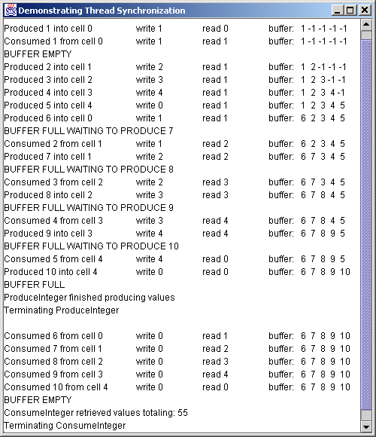
Program Output

Slide 45
15.9 Daemon Threads
Runs for benefit of other threads
  Do not prevent program from terminating
  Garbage is a daemon thread
Set daemon thread with method setDaemon

Slide 46
15.10 Runnable Interface
Multithreading in a class that extends a class
  A class cannot extend more than one class
  Implements Runnable for multithreading support
Runnable object grouped with a Thread object

Slide 47
RandomCharacters.java
Line 16
1 // Fig. 15.17: RandomCharacters.java
2 // Demonstrating the Runnable interface.
3
4 // Java core packages
5 import java.awt.*;
6 import java.awt.event.*;
7
8 // Java extension packages
9 import javax.swing.*;
10
11 public class RandomCharacters extends JApplet
12 implements ActionListener {
13
14 // declare variables used by applet and
15 // inner class RunnableObject
16 private String alphabet = "ABCDEFGHIJKLMNOPQRSTUVWXYZ";
17 private final static int SIZE = 3;
18
19 private JLabel outputs[];
20 private JCheckBox checkboxes[];
21
22 private Thread threads[];
23 private boolean suspended[];
24
25 // set up GUI and arrays
26 public void init()
27 {
28 outputs = new JLabel[ SIZE ];
29 checkboxes = new JCheckBox[ SIZE ];
30 threads = new Thread[ SIZE ];
31 suspended = new boolean[ SIZE ];
32
33 Container container = getContentPane();
34 container.setLayout( new GridLayout( SIZE, 2, 5, 5 ) );
35
String alphabet shared by three threads

Slide 48
RandomCharacters.java
Lines 52-65
Lines 59-60
Lines 63
36 // create GUI components, register listeners and attach
37 // components to content pane
38 for ( int count = 0; count < SIZE; count++ ) {
39 outputs[ count ] = new JLabel();
40 outputs[ count ].setBackground( Color.green );
41 outputs[ count ].setOpaque( true );
42 container.add( outputs[ count ] );
43
44 checkboxes[ count ] = new JCheckBox( "Suspended" );
45 checkboxes[ count ].addActionListener( this );
46 container.add( checkboxes[ count ] );
47 }
48 }
49
50 // Create and start threads. This method called after init
51 // and when user revists Web page containing this applet
52 public void start()
53 {
54 // create threads and start every time start is called
55 for ( int count = 0; count < threads.length; count++ ) {
56
57 // create Thread and initialize it with object that
58 // implements Runnable
59 threads[ count ] = new Thread( new RunnableObject(),
60 "Thread " + ( count + 1 ) );
61
62 // begin executing Thread
63 threads[ count ].start();
64 }
65 }
66
Applet start method
Instantiate three Thread objects and initialize each with an instance of RunnableObject
Call thread start method

Slide 49
RandomCharacters.java
Lines 68-76
Lines 79-90
Lines 84-85
Line 89
Method getIndex determines index of currently executing thread
67 // determine thread location in threads array
68 private int getIndex( Thread current )
69 {
70 for ( int count = 0; count < threads.length; count++ )
71
72 if ( current == threads[ count ] )
73 return count;
74
75 return -1;
76 }
77
78 // called when user switches Web pages; stops all threads
79 public synchronized void stop()
80 {
81 // Indicate that each thread should terminate. Setting
82 // these references to null causes each thread's run
83 // method to complete execution.
84 for ( int count = 0; count < threads.length; count++ )
85 threads[ count ] = null;
86
87 // make all waiting threads ready to execute, so they
88 // can terminate themselves
89 notifyAll();
90 }
91
Method stop stops all threads
Set thread references in array threads to null
Invoke method notifyAll to ready waiting threads

Slide 50
RandomCharacters.java
Lines 93-111
Line 98
Lines 101-102
Line 106
Line 120
Line 123
Line 126
Method actionPerformed detects clicking Suspended checkboxes
92 // handle button events
93 public synchronized void actionPerformed( ActionEvent event )
94 {
95 for ( int count = 0; count < checkboxes.length; count++ ) {
96
97 if ( event.getSource() == checkboxes[ count ] ) {
98 suspended[ count ] = !suspended[ count ];
99
100 // change label color on suspend/resume
101 outputs[ count ].setBackground(
102 !suspended[ count ] ? Color.green : Color.red );
103
104 // if thread resumed, make sure it starts executing
105 if ( !suspended[ count ] )
106 notifyAll();
107
108 return;
109 }
110 }
111 }
112
113 // private inner class that implements Runnable so objects
114 // of this class can control threads
115 private class RunnableObject implements Runnable {
116
117 // Place random characters in GUI. Local variables
118 // currentThread and index are declared final so
119 // they can be used in an anonymous inner class.
120 public void run()
121 {
122 // get reference to executing thread
123 final Thread currentThread = Thread.currentThread();
124
125 // determine thread's position in array
126 final int index = getIndex( currentThread );
Toggle boolean value in array suspended
Set background color of the JLabel to red or green
Method run uses two local variables
Call notifyAll to start ready threads
Method currentThread gets reference to executing thread
Inner class RunnableObject controls threads
Method getIndex determines index of currently running thread

Slide 51
RandomCharacters.java
Lines 129-179
Line 133
Lines 137-147
Line 144
127
128 // loop condition determines when thread should stop
129 while ( threads[ index ] == currentThread ) {
130
131 // sleep from 0 to 1 second
132 try {
133 Thread.sleep( ( int ) ( Math.random() * 1000 ) );
134
135 // Determine whether thread should suspend
136 // execution. Use applet as monitor.
137 synchronized( RandomCharacters.this ) {
138
139 while ( suspended[ index ] &&
140 threads[ index ] == currentThread ) {
141
142 // Temporarily stop thread execution. Use
143 // applet as monitor.
144 RandomCharacters.this.wait();
145 }
146
147 } // end synchronized block
148 }
149
150 // process InterruptedExceptions during sleep or wait
151 catch ( InterruptedException interruptedException ) {
152 System.err.println( "sleep interrupted" );
153 }
154
The while loop executes as long as the index of array threads equals currentThread
Thread sleeps 0 to 1 second
The synchronized block helps suspend currently executing thread
Invoke method wait on applet to place thread in waiting state

Slide 52
RandomCharacters.java
Lines 156-177
Lines 161-171
Method invokeLater updates JLabel for appropriate thread
155 // display character on corresponding label
156 SwingUtilities.invokeLater(
157
158 // anonymous inner class used by SwingUtilities
159 // method invokeLater to ensure GUI
160 // updates properly
161 new Runnable() {
162
163 // updates Swing GUI component
164 public void run()
165 {
166 // pick random character
167 char displayChar = alphabet.charAt(
168 ( int ) ( Math.random() * 26 ) );
169
170 outputs[ index ].setText(
171 currentThread.getName() + ": " +
172 displayChar );
173 }
174
175 } // end anonymous inner class
176
177 ); // end call to SwingUtilities.invokeLater
178
179 } // end while
180
181 System.err.println(
182 currentThread.getName() + " terminating" );
183 }
184
185 } // end private inner class RunnableObject
186
187 } // end class RandomCharacters
Anonymous inner class implements Runnable interface

Slide 53
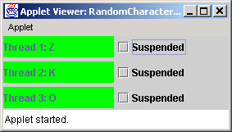
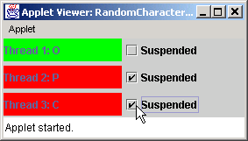
Program Output

Slide 54
15.11 Thread Groups
Class ThreadGroup
  Create and manipulate groups of threads
  Each group has unique name at creation
Parent and child thread groups
  Method calls sent to parent group also sent to child groups

Slide 55
15.12 (Optional Case Study) Thinking About Objects: Multithreading
Concurrent models
  UML contains support for building concurrent models
  Discus how simulation benefits from multithreading
    waitingPassenger must wait for ridingPassenger to exit Elevator
    Use synchronized method
      Guarantees only one Person in Elevator at a time

Slide 56
15.12 (Optional Case Study) Thinking About Objects: Multithreading
Threads, Active Classes and Synchronized method
  UML represents a thread as an active class
    Thick black border in UML diagram indicates an active class
  Synchronized Methods in UML
    Notation B/A to indicates A must wait for B to finish

Slide 57
15.12 (Optional Case Study) Thinking About Objects: Multithreading
Sequence Diagrams
  Shows interactions between objects
    Shows messages passed between objects over time
  Rectangle enclosing an object name represents that object
    Use same naming conventions as collaboration diagrams
  Lifeline
    Dotted line running down from an object name
    Actions occur on lifeline in chronological order, top to bottom
  Arrows
    Dashed arrows
      Represent “return messages,” return of control to object
    Solid arrows
      A message sent from one object to another

Slide 58
15.12 (Optional Case Study) Thinking About Objects: Multithreading
Class diagram now uses active classes
  Elevator and Person are now active classes

Slide 59
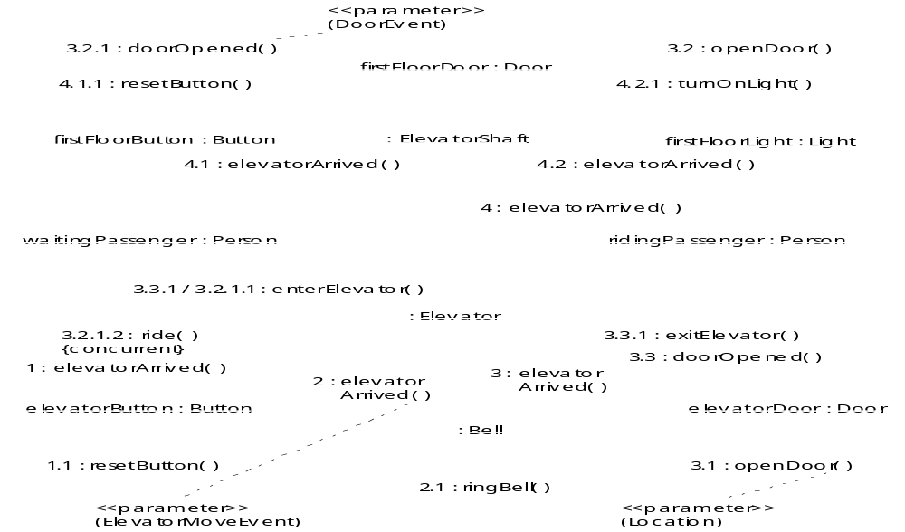
15.12 (Optional Case Study) Thinking About Objects: Multithreading
Fig. 15.18 Modified collaboration diagram with active classes for passengers entering and exiting the Elevator.

Slide 60
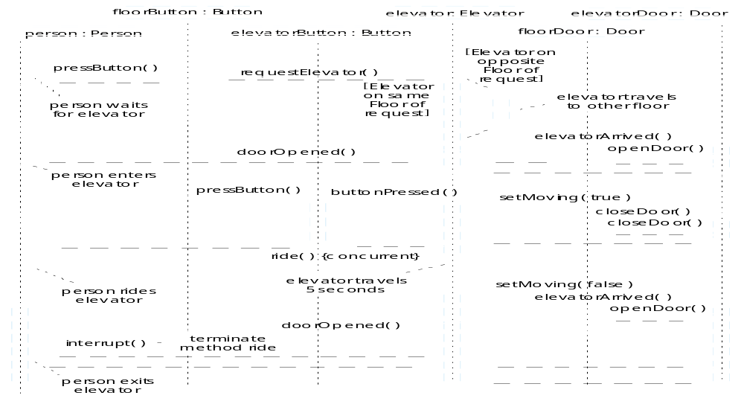
15.12 (Optional Case Study) Thinking About Objects: Multithreading
Fig. 15.19 Sequence diagram for a single Person changing floors in system.

Slide 61
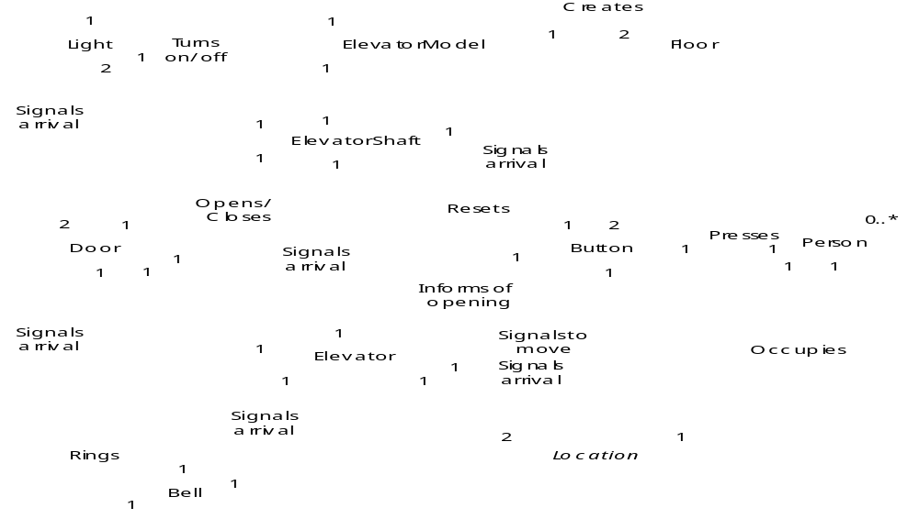
15.12 (Optional Case Study) Thinking About Objects: Multithreading
Fig. 15.20 Final class diagram of the elevator simulation

Slide 62
15.13 (Optional) Discovering Design Patterns: Concurrent Design Patterns
Concurrency Design Patterns
  Single-Threaded Execution design pattern
    Stops several threads from invoking a method concurrently
  Guarded Suspension design pattern
    Suspends and resumes a threads activity when a condition met
  Balking design pattern
    Causes method to balk if an object occupies a certain state
  Read/Write Lock design pattern
    Multiple read on an object but exclusive write
  Two-Phase Termination design pattern
    Uses two-phase termination process to ensure resources freed

Slide 63
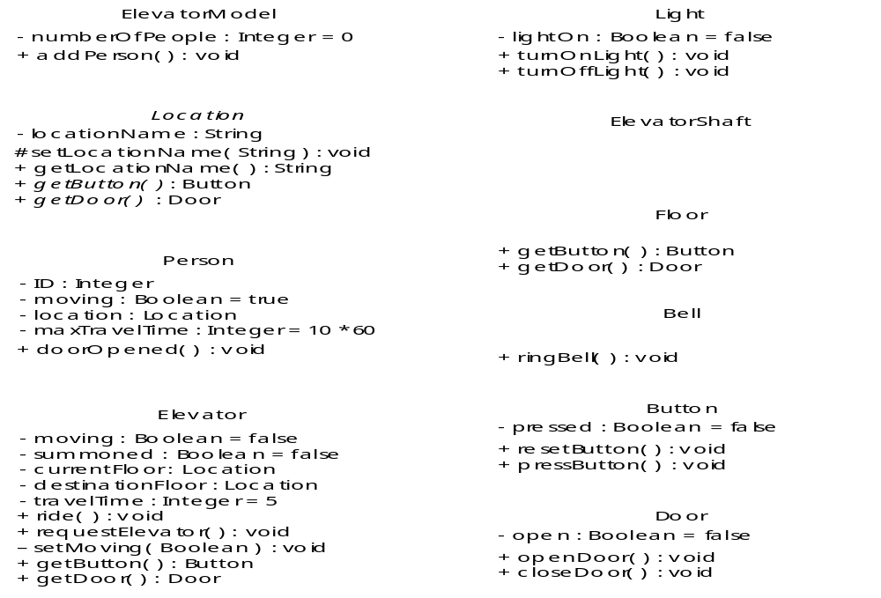
15.13 (Optional) Discovering Design Patterns: Concurrent Design Patterns
Fig. 15.21 Final class diagram with attributes and operations.

